Slide 1
Introduction of Lecturer & Course Polices
Course Code: CSC 3224
Course Title: Computer Graphics
Dept. of Computer Science
Faculty of Science and Technology
Lecturer No: | 1 | Week No: | 01 | Semester: | Spring 24-25
Lecturer: | Dipta Justin Gomes

Slide 2
Vision and Mission of CS, AIUB
Vision:
Provides leadership in the pursuit of quality and excellent computer education and produce highly skilled and globally competitive IT professionals.
Mission:
Committed to educate students to think analytically and communicate effectively; train them to acquire technological, industry and research-oriented accepted skills; keep them abreast of the new trends and progress in the world of information communication technology; and inculcate in them the value of professional ethics.

Slide 3
Outline
- Introduction of Lecturer
- Mission and Vision of CS, AIUB
- Rules Polices of the class/lab
- Attendance policy of class/lab
- Grading Policy
- Makeup Policy
- Dropping Policy
- Final Thoughts
- Consulting Hours

Slide 4
Goals of CS, AIUB
Enrich the computer education curriculum to suit the needs of the industry- wide standards for both domestic and international markets
Equip the faculty and staff with professional, modern technological and research skills
Upgrade continuously computer hardware's, facilities and instructional materials to cope with the challenges of the information technology age
Initiate and conduct relevant research, software development and outreach services.
Establish linkage with industry and other IT-based organizations/institutions for sharing of resources and expertise, and better job opportunities for students

Slide 5
Rules of Class
Please keep silence during lecture time.
No attendance after 15 minutes of starting of Lecture class and 20 minutes in Lab Class.
There will be session for questioning after completing each topic and subtopic.
Please ask your personal question in break /after finishing lecture/ consulting hours.
If some of you already know the materials I am discussing, give chance other students to understand the matter.
No Exam policy for attendance(class and lab) less than 75%.

Slide 6
Lab Policy
First 1 hour will be spent explaining the problems/task/experiment to be performed.
Next 1 hour will be spent by the students to complete the experiment.
Rest 20 minutes will be spent in checking, marking, and discussing the solution.
Students are allowed to discuss with each other (unless instructed not to) in solving problems.
But the checking (executing/viva) & marking will be with individual students only.

Slide 7
Attendance Policy
At least 75% presence is required by the student. Absent classes must be defended by the student through application and proper documentation to the course teacher.
Single absences or absences within 25% range will be judged by the course teacher.
Long absences/irregular presence/absences out of 25% range must go through application procedures via department Head (+ probation office, if student is in probation) to attend the following classes.
Acceptance of an application for absence only gives permission to attend the following classes. This might still result in deduction of marks (for attendance) which will be judged by the course teacher

Slide 8
Grading Policy
All the evaluation categories & marks will be uploaded to the VUES within one week of the evaluation process except the attendance & performance, which will be uploaded along with the major (mid/final term) written exam marks.
Letter grades ‘A+’ through ‘F’ is counted as grades. Other grades ‘I’ and ‘UW’ are considered as temporary grades which are counted/calculated as ‘F’ grade in the CGPA. These grades must/will be converted to the actual grades, i.e. ‘A+’ through ‘F’.
‘I: INCOMPLETE’ is given to students who have missed at most 30% of evaluation categories (quiz/assignment/etc.). Students must contact the course teacher for makeup, through valid application procedures immediately after grade release.
‘UW: UNOFFICIAL WITHDRAW’ is given when the missing evaluation categories are too high (more than 30%) to makeup. A student getting ‘UW’ has no option but to drop the course immediately after grade release

Slide 9
Dropping Policy
Must fill up the drop form and get it signed by the course teacher, write an application to the vice chancellor and get it signed by the department Head, and finally submit the form & application to the registration department.
The course teacher must write down the grades (if any) obtained in midterm, final, and grand total on the drop form.
No drop is accepted during the following periods:
One week before midterm exam – grade release date of midterm exam.
One week before final term exam – grade release date of final grade.
Student with ‘F’ grades in midterm, final term, or grand total cannot drop.
Probation student are not allowed to drop any course

Slide 10
Other Policy
For any problems that could not be solved/understood during the lecture, students are advised to contact during the consultation hours and solve the problem.
For any missing evaluation (quiz, assignment, etc.), classes, deadlines, etc. must contact/inform/notify the teacher immediately after missing in the consulting hour, via email, or in unavoidable circumstances – through the guardian or friend.
Probation students must meet the course teacher once a week. So schedule your time with the teacher.
Any kind of dishonesty, plagiarism, misbehavior, misconduct, etc. will not be tolerated. Might result in deduction of marks, ‘F’ grade, or reported to the AIUB Disciplinary Committee for drastic punishment.
Always check/visit the AIUB home page and portal for notices, rules & regulations of academic/university policies and important announcement for deadlines (Course drop, Exam permit, Exam Schedule, etc.).

Slide 11
Other Policy
No dropping of the course is allowed after Mid-Term Examination.
Two Quizzes will be taken both in Mid-Term and Final Term, where the best of the two quizzes will be taken.
No makeup quiz will be taken without any valid cause or documents. Students needs to attend either one of the quizzes if there are no valid cause of absence.
Bonus marks may be provided to students with full attendance, regularity in class and class engagement.
For scheduling an in-person consultation in my office, the student must contact me via Teams in order to schedule a meeting. (Refer to my TSF)
It is mandatory to attend a consultation session in Midterm and a consultation session in Final Term. Unable to attend at least 2 consultations may result in decrease of performance marks in the Overall Grade.

Slide 12
Important Policy
Special Grade Policy:
Failure to attend any major assessments such as Term exam, both quizzes will result in a I grade.
Students with attendance below 75% in Mid-Term will automatically receive an UW grade.
Students with overall marks below 50% and not eligible for I and UW grade will get an F grade.
Regarding any disciplinary occurrence may result in withdrawal from the course

Slide 13





Introduction of Lecturer
Designation, Office Details
Dipta Justin Gomes
Lecturer
Department of Computer Science
Faculty of Science & Technology
Office: D Building, Level 7, DE0701K
Email: diptagomes@aiub.edu | diptagomes@gmail.com
American International University-Bangladesh (AIUB)

Slide 14
Introduction of Lecturer
Educational Background
Doctor of Philosophy (Ph.D.) in Computer Science and Engineering
Bangladesh University of Engineering and Technology (BUET)
Advanced Visualization, Embedding and Drawing Algorithms for Non-planar Graphs
(2024 - Ongoing)
MSc in Computer Science
Specializing in Computer Vision
University of Ulster, Northern Ireland, UK
(2021-2023)
MSc in Computer Science
Specializing in Intelligent Systems
American International University-Bangladesh (AIUB)
(2018-2019)

Slide 15
Introduction of Lecturer
Research Interests
Algorithms
Graph Drawing and Visualization
Computer Vision
Machine Learning
Drone and IoT

Slide 16
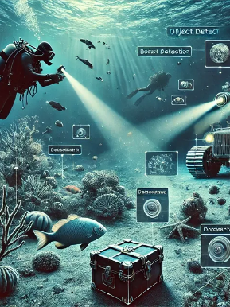
Notable Research Works
Robust Underwater Object Detection with Autonomous Underwater Vehicle
Underwater Object Detection had been one of the most challenging research fields of Computer Vision and Image Processing.
Underwater Autonomous Vehicles (UAV) has been developed to capture real time videos for specific object detection. Using different hardware improvements and using many varied forms of algorithms, classification of objects, mainly living objects had been carried with different AUVs and high-resolution cameras.
Conventional object detection methods of Computer Vision fail to provide accurate detection results due to some challenges faced underwater.
Link

Slide 17

Notable Research Works
Classification of Food Objects using Deep Convolutional Neural Network using Transfer learning
A fine-tuned model based on the Xception Convolutional Neural Network model trained with transfer learning has been proposed with a promising accuracy of 95.20% which indicates a greater scope of accurately classifying food objects with Xception deep learning model.
Higher rate of accuracy opens the door of further research of identifying various new types of food objects through a robust approach.
The main contribution in the research is better fine-tuning features of food classification. The dataset used in this research is the Food-101 Dataset containing 101 classes of food object Images in the dataset.
Link

Slide 18
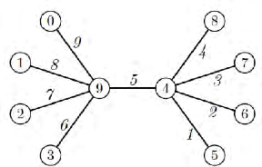
Notable Research Works
Graceful Cascading Labelling Algorithm: Construction of Graceful Labelling of Trees
The Graceful Labelling of Trees is one of the most challenging Conjectures in Graph Theory, proudly known as the Disease of Graph theory which still remains a challenge as it remains unsolved.
To counter the Conjecture, an algorithm is proposed to construct a Graceful Binary tree and a Graceful Caterpillar Tree.
The result is known that all graphs are Graceful, but no algorithm of graceful labelling of graphs has yet been proposed. In this paper, we are proposing a simple method of graceful labelling Binary Cascading Caterpillar Trees and Complete Binary Graphs.
Link

Slide 19
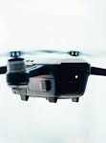
Notable Research Works
Enhancing capabilities and security features of Drone Networks through Machine Learning: A Comprehensive Overview Link
The integration of machine learni ng algorithms into drone networks offers significant opportunities to enhance the processing power and security of Unmanned Aerial Vehicles (UAVs).
By analyzing large datasets, drones can achieve improved situational awareness, predictive maintenance, and optimized mission planning through adaptive reinforcement learning and deep reinforcement learning.
Techniques like federated learning, collaborative swarm intelligence, and ensemble learning contribute to the accuracy and effectiveness of drone operations, making them valuable in applications such as traffic management, disaster response, smart city infrastructure, and agricultural monitoring.
it explores future directions, including the development of advanced machine learning algorithms, edge computing, interoperability, ethical frameworks, multi-domain integration, resilience, and human-drone interaction

Slide 20
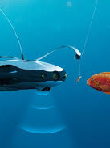
Notable Research Works
Robust Underwater Fish Detection Using an Enhanced Convolutional Neural Net
Underwater Object Detection is one of the most challenging and unexplored domains in this area of Computer Vision.
The proposed research refines the image enhancement of under-water imagery by proposing an improvement of already existing tools for underwater Object detection.
The comparative study clearly depicts the enhancement of the proposed method with respect to the existing methods for underwater object detection. Moreover, a framework for detection of underwater organisms such as fishes are proposed, which will act as the steppingstone for re- serving the ecosystem of the whole fish community.
Through this enhancement and through finding a healthy environment for their breeding ground, the extinction of selected species of fishes is can be diminished and decreasedThe proposed method is a modified VGGNet-16, which is trained using the ImageCLEF FISH_TS dataset. The overall result provides an accuracy of 96.4% which surpasses all its predecessors.
LINK

Slide 21
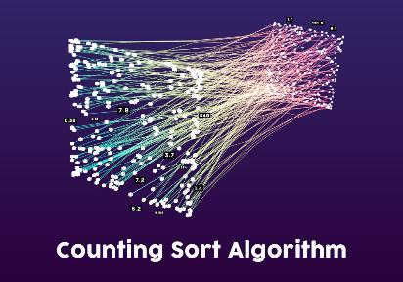
An Efficient Integrated Negative Fractional Counting Sort Algorithm
The time complexity of the Counting Sort algorithm is linear and is famous for sorting non-negative integers (0-positive). It runs well for a possible small difference between the smallest and largest number in the input data series to avoid redundant unused memory space.
So far studied in the literature, the traditional counting sort algorithm may also be applied to sort all integers (negative-0-positive) in such a way that positive and negative integers will be dealt with separately to sort. In this paper, we propose a integrated form of counting sort algorithm to sort all real numbers, and we call it the “negative fractional counting sort” method that can efficiently sort arrays with negative and positive integers along with fractional numbers.
While the input array has been extended from the integer range 0 to K to the fractional range from –ve fractional number to +ve fractional number, the time complexity remains linear. The proposed method involves separately sorting the negative and positive component.
LINK

Slide 22
Research Opportunities
Some Interesting Research topics on Algorithms:
Approaches of Blind Graph Topology Change Detection
Developing Low Memory Algorithms
Graph Drawing Algorithms for selected sub-class of graphs
Addressing Graph Conjectures (Graceful Labelling, Magic Labelling etc.) for certain sub-class of graphs
Graph Spanner
Research on Network Science (Community Detection and network Analysis)
Research relating PCG and Drones
Modified Fortune’s algorithm for Voronoi generation
Etc.

Slide 23
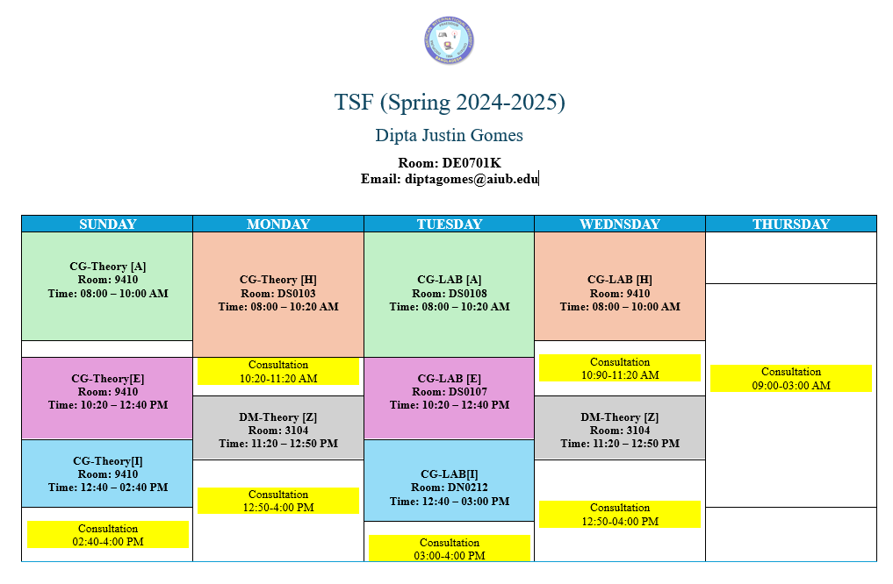
Consulting Hours

Slide 24
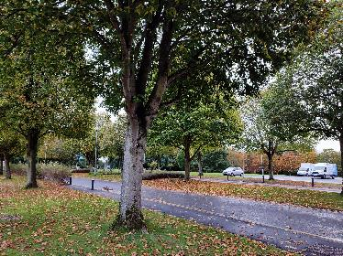

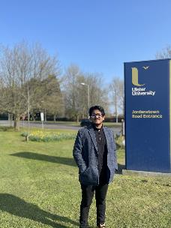
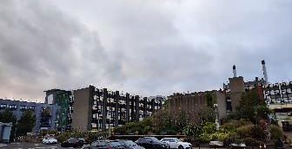
Memories
University of Ulster, Jordanstown, Northern Ireland, UK

Slide 25
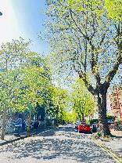
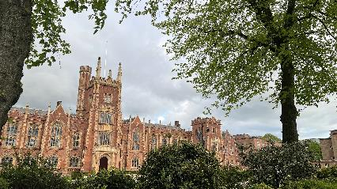
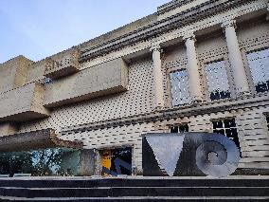
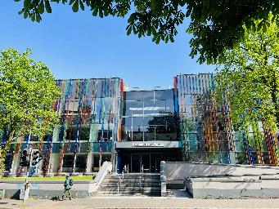
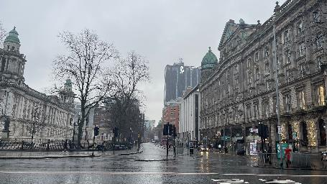
Memories
Queen’s University Belfast, Northern Ireland

Slide 26
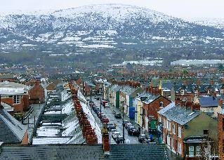

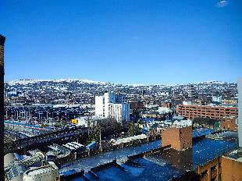

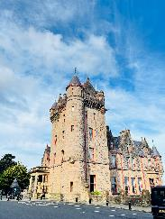
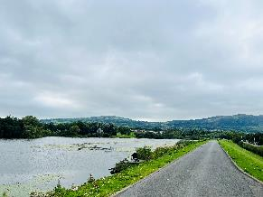

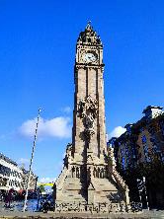
Memories
Belfast, Northern Ireland, UK (2021-2024)

Slide 27
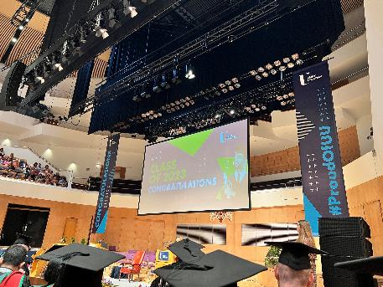
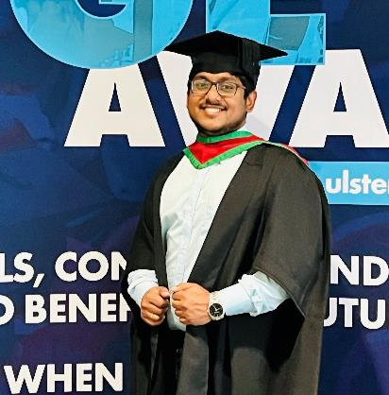
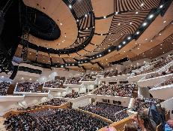
M.Sc. Graduation, University of Ulster

Slide 28
Course Evaluation
Midterm | Quiz | 20
 | Laboratory Performance/Assignment/Exam | 30
 | Class Attendance/Performance | 10
 | Midterm Written Exam | 40
 | Midterm Total | 100 | 40%
Final term | Quiz | 20
 | Laboratory Performance/Assignment/Exam | 30
 | Class Attendance/Performance | 10
 | Final term Written Exam | 40
 | Final Term Total | 100 | 60%
Grand Total | Final Grade of the Course |  | 100

Slide 29
Welcome to the course
Algorithms

Slide 30
??????
What will we do/learn in this course?

Slide 31
The Goals of this Course
To think algorithmically
To understand and learn the idea behind algorithm design techniques
To get to know a toolbox of classical algorithms.
To reason (in a precise and formal way) about the efficiency and the correctness of algorithms.

Slide 32
I would request all of you to...
Be simple and precise in understanding the problem
Solve the problem first on the paper and then keyed in on the computer.
During lectures:
Interaction is welcome; ask questions.
Additional explanations and examples if desired.
Speed up/slow down the progress.

Slide 33
??????
What is Algorithm?

Slide 34
Informally
takes some value or set of values as input
produces some value or set of values, as output
Algorithm: any well-defined computational procedure
An algorithm is thus a sequence of computational steps that transform the input into the output.
Solving a given problem:
Data structure: Organization of data to solve the problem at hand.
Algorithm: Outline, the essence of a computational procedure, step-by-step instructions.
Program: Implementation of an algorithm in some programming language.

Slide 35
Kinds of Problem to be solved
Sorting and Searching are the basic and most common computational problem.
Clever algorithms are employed for the Internet
to manage large volume of data transfer.
Finding good routes on which the data will travel.
Search engine to quickly find requested pages.
Etc…
Numerical algorithms and number theory are employed in electronic commerce to keep and secure information such as credit card numbers, passwords, and bank statements.

Slide 36
Kinds of Problem to be solved
Allocating scarce resources in the most beneficial way.
An oil company may wish to know where to place its wells in order to maximize its expected profit.
A candidate may want to determine where to spend money buying campaign advertising in order to maximize the chances of winning at election.
An airline may wish to assign crews to flight in the least expensive way possible, making sure that each flight is covered and that government policy regarding crew policies are met.
Etc…

Slide 37
Algorithmic problem
Specification of output as a function of input
Specification of input
Algorithm
Finite number of input instances satisfying the specification.
For example:
A sorted, non-decreasing sequence of natural numbers. The sequence is of non-zero, finite length:
1, 20, 908, 909, 100000, 1000000000.
3.

Slide 38
Algorithmic Solution
Input instance, adhering to the specification
Output related to the input as required
Algorithm
Algorithm describes actions on the input instance.
There may be many correct algorithms for the same algorithmic problem.
Introduction→38

Slide 39
Definition of an Algorithm
An algorithm is a sequence of unambiguous instructions for solving a problem, i.e., for obtaining a required output for any legitimate input in a finite amount of time.
Properties:
Precision
Determinism
Finiteness
Efficiency
Correctness
Generality

Slide 40
Overall Picture
Using a computer to help solve
problems.
Precisely specify the problem.
Designing programs
Architecture → data structure
Technique → algorithms
Writing programs
Verifying (testing) programs
Data Structure and Algorithm Design Goals
Correctness
Efficiency
Implementation Goals
Adaptability
Reusability
Robustness

Slide 41
How to Develop an Algorithm?
Precisely define the problem.
Precisely specify the input and output.
Consider all cases.
Come up with a simple plan to solve the problem at hand.
The plan is language independent.
The precise problem specification influences the plan.
Turn the plan into an implementation
The problem representation (data structure) influences the implementation.

Slide 42
??????
Suppose computers were infinitely fast and computer memory was free. Would you have any reason to study algorithms?

Slide 43
FINAL THOUGHTS
Don’t Run For Grades
Run For Knowledge

